Slide 1
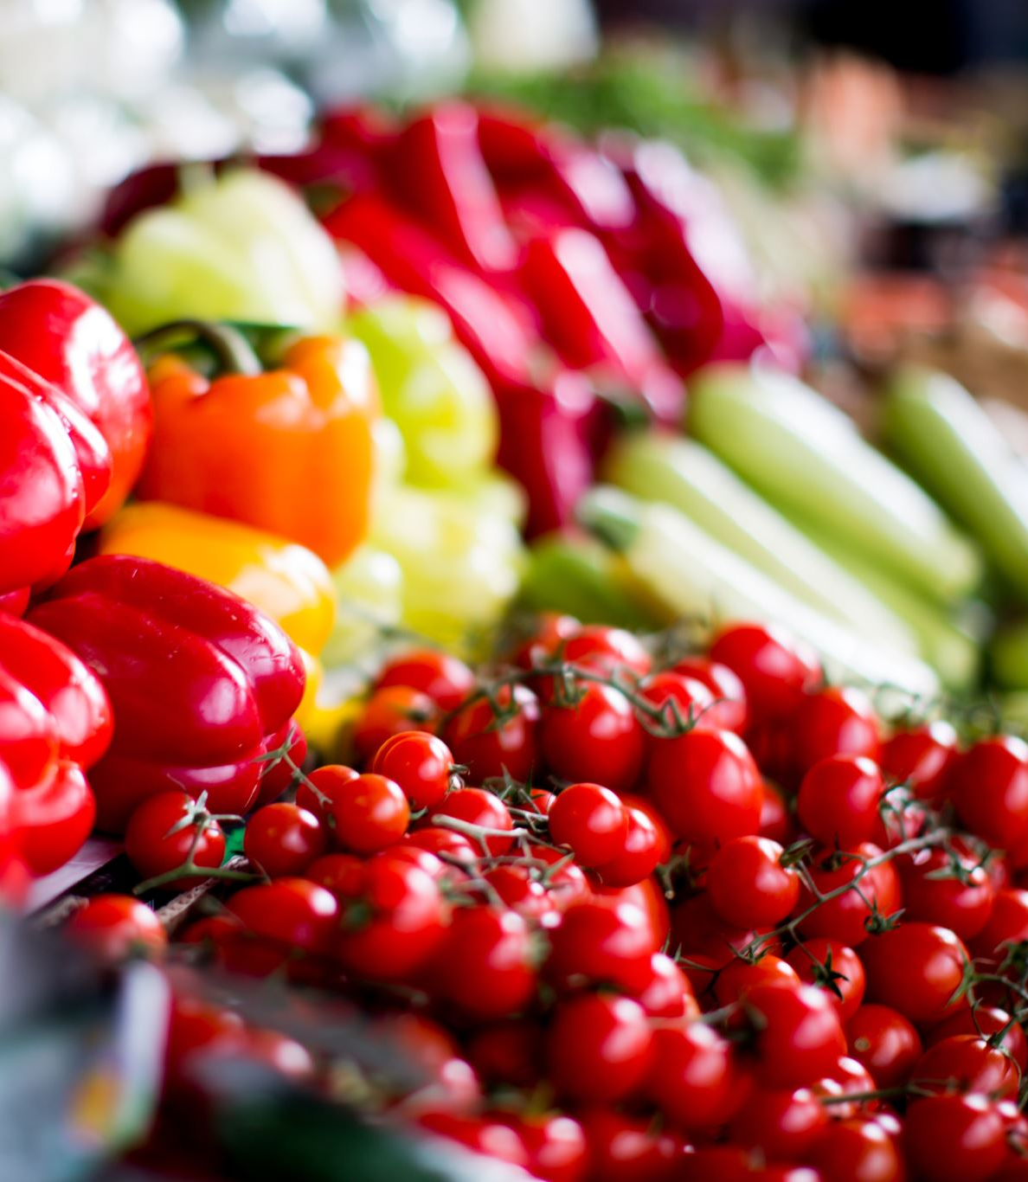




Tredence Last Mile Hackers Retail Recommender
Team – The.Deep.Learner
Devansh Batra
Lakshay Vohra
Manideep Sharma
Utkarsh Bajaj

Slide 2
Contents
1
Problem Statement
2
Exploratory Data Analysis
Retail Recommender
3
Feature Engineering
4
Model Selection
5
Future Scope

Slide 3









Problem Statement – 1.) Use AI/ML to predict whether the customer will reorder a product or not 2.) Recommend a surprise product that customer would like to buy
Problem Statement
Solution workflow
Prepare the data
Perform EDA
Perform Feature Engineering
Data Split (70:30)
Train the model on various classification techniques
Compare the models on F1 score and make final predictions on Test dataset
Descriptive Analytics
Predictive Analytics
Validate the model on 30% data
Recommends a surprise product for the customers

Slide 4
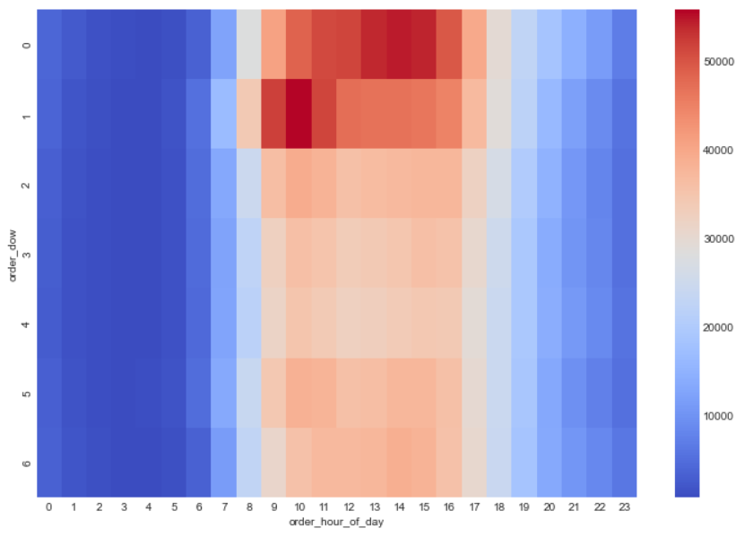
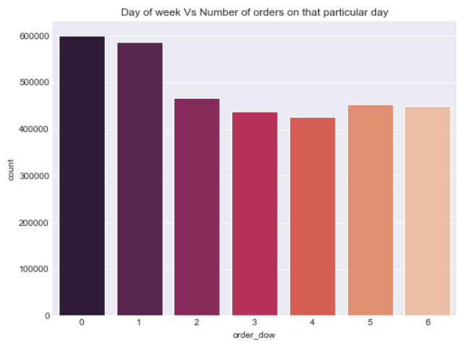
Seasonality: Customers are more likely to buy during the weekends, with more orders going through during the middle of the day
Exploratory Data Analysis
Saturdays and Sundays are most popular for placing orders
Orders are largely placed during the middle of the day, with 9AM to 4PM being the most popular hours

Slide 5
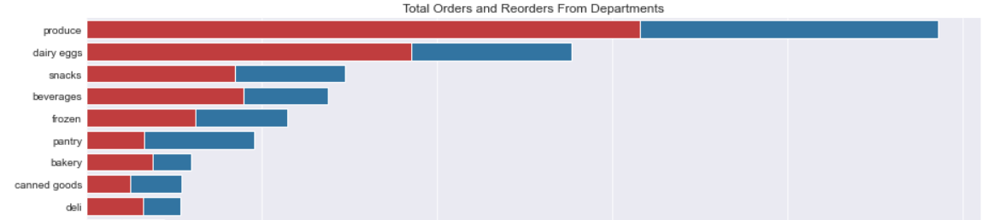
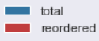
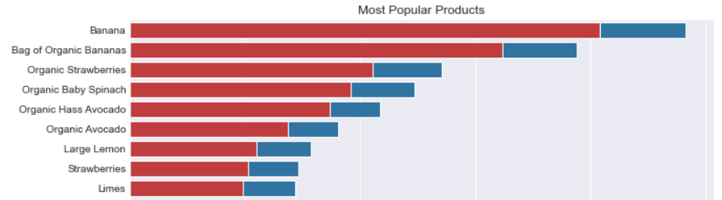
Produce and dairy eggs are the most popular departments, with bananas and strawberries being the most popular products
Exploratory Data Analysis
~65% of produce and eggs orders are reorders. Pantry items are popular but have relatively lower reorder ratio* of ~35%
Produce has high reorder ratio across products, with organic products being especially popular
*Reorder Ratio: Percentage of total orders that are reorders

Slide 6
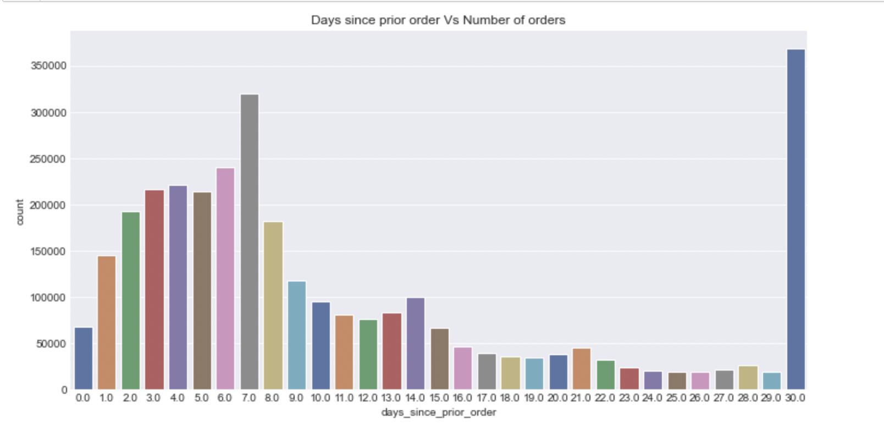
Customers are more likely to order after every 7 days
Exploratory Data Analysis

Slide 7
Various features were added based product info, department info and prior order details
Feature Engineering
Following features were joined with training data from ‘orders’, ‘department’, and ‘aisles’ datasets:
Base features
Aisle ID, Department ID, Days since prior order, Order number, Order DOW, Order hour of day
* Order DOW and Hour of day was one-hot encoded
Reorder Ratio
Reorder ratio (percentage of orders that are reorders) was added for each Department ID and Aisle ID
For each user, a ‘product_count_user’ feature was added that identifies the number of times a user has previously ordered a product.
Prior Orders

Slide 8
Model Selection – Selecting the best classification model based on F1 and AUC score
Prepared train-validation set by splitting the original train data into 70:30 ratio so that 70% of each user’s orders will go into training set and 30% into validation set
Features/Output | With Base features | +Reorder Ratio | + Prior re-order history
Models applied | F1 Score | F1 Score | F1 Score
Logistic Regression |  | 0.7527 | 1
XGBoost |  | 0.74 | 1
LightGBM | 0.76 |  | 1
Random Forrest |  | 0.736 | 1
Decision Tree |  |  | 1
Gaussian |  |  | 0.98
LightGBM has proven to be the best model for this analysis which produced an F1 score of 0.74, 0.75, and 1 after doing feature engineering with base features, reorder ratio and prior re-order history

Slide 9
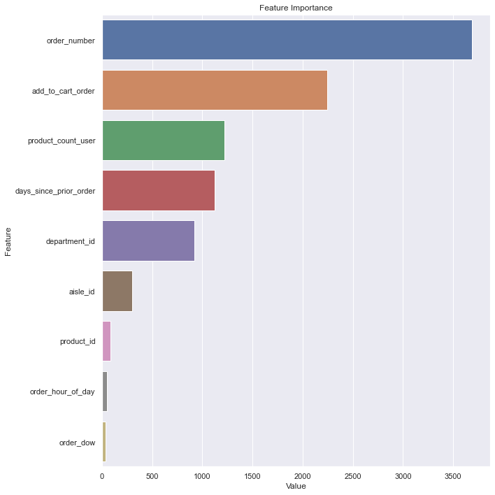
LightGBM based model was selected for final training
Model Results
Hyper Parameters tuned
Low depth value was kept for initial iterations. Subsequently, higher depth value was tried
Since F1 score was same for different depth values, the tree with lower depth (more pruned) was selected for final predictions
 | Validation F1 Score | Test Data F1 Score
Num_leaves = 10
depth = 5 | 1 | 1
depth = 7 | 1

Slide 10
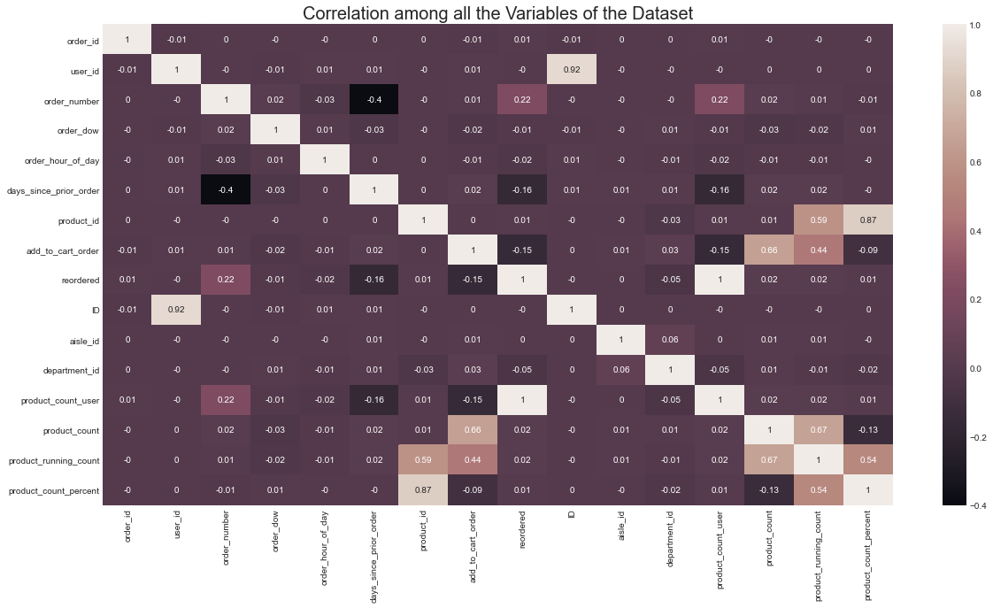
Why is the F1 score so high for the selected model? The ‘product_count_user’ variable has high correlation with the reorder values
Model Results
product_count_user (derived from prior order history) has perfect correlation with the target variable, leading to very high model F1 score

